Slide 1
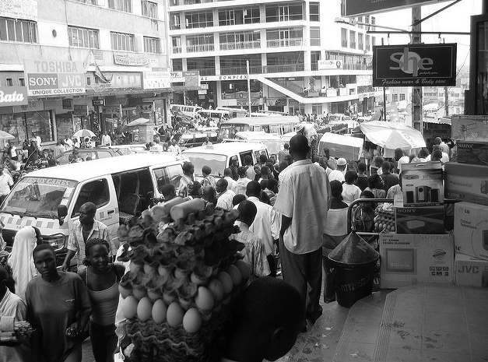
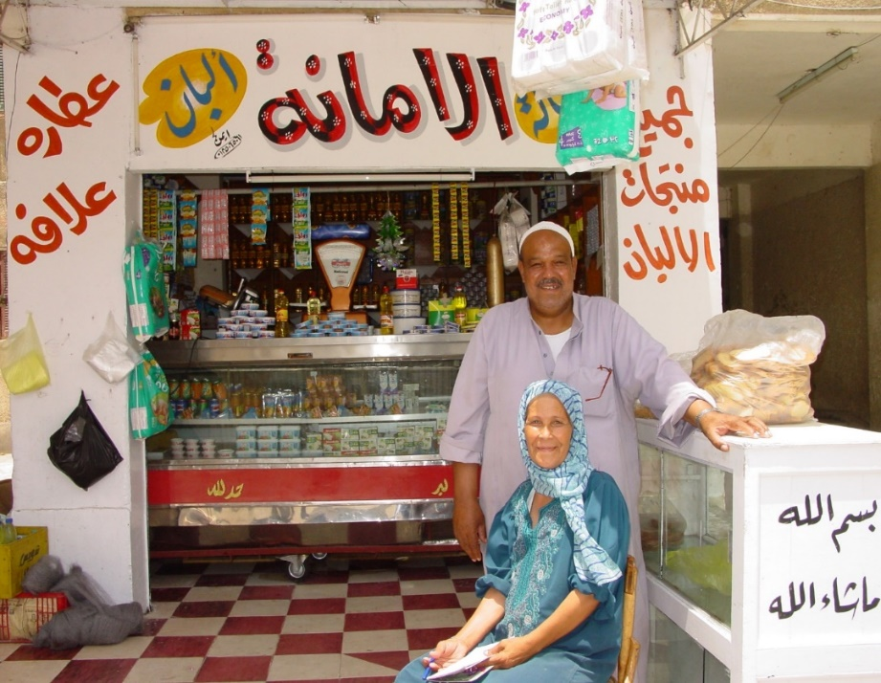
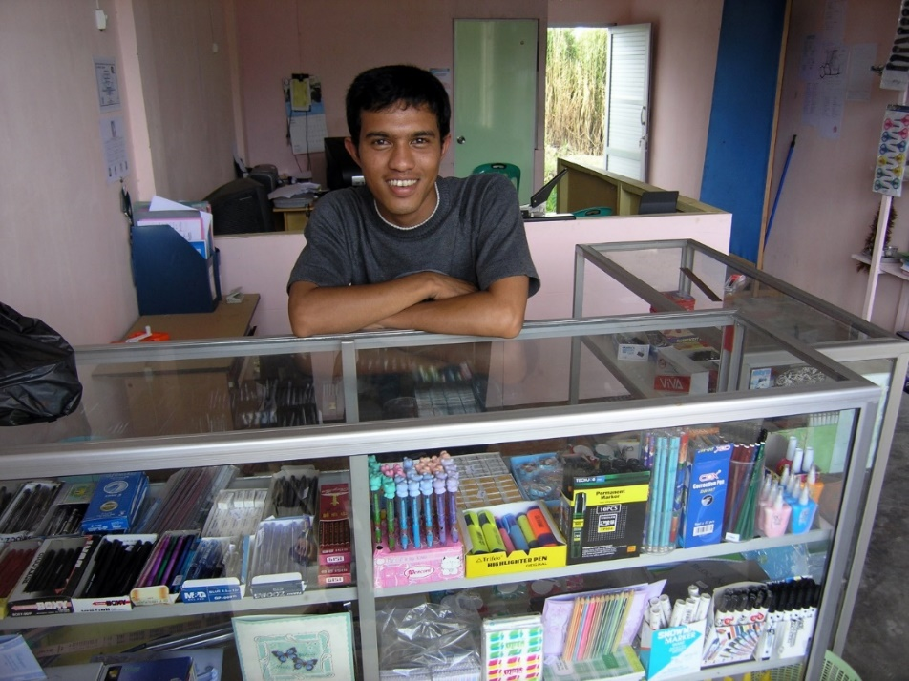
Business Preparedness Initiative
August 2018
Notes:
The Business Preparedness Initiative aims to protect livelihoods and promote more comprehensive community resilience. It does so by providing easy-to-use, adaptable and scalable tools for small business preparedness. Small businesses are instrumental in restoring/maintaining economic activity at a community level in the wake of disasters or epidemic outbreaks.
Photo Credits: Top Left - Chris Guillebeau/Flickr CC BY-NC 2.0
Bottom Left – USAID/Flickr CC BY-NC 2.0

Slide 2
Combined data from country studies: “Strengthening the Disaster Resilience of Small and Medium Enterprises in Asia” Project
Notes:
Studies have shown that the vast majority of small and medium enterprises do not actively plan ahead for disasters. This is due to a high financial cost and lack of actionable guidance on how to plan ahead. As a result, when disasters strike hardships result not only for businesses, but also the surrounding community.
While a specific study has not been done in Uganda, our interviews with the business community under this program indicate a very low level of disaster and epidemic preparedness planning, and confirm the relevance of this initiative here.

Slide 3
Business Workshops for business owners and managers to gain key information through concise 4.5 hour interactions.
Volunteer visits to share key messages on business continuity & resilience
Atlas Ready for Business App
BPI Offerings
Notes:
To lower key barriers and promote increased business preparedness in case of disasters or epidemics the Red Cross is leading a Business Preparedness Initiative in Kampala and Kasese, in collaboration with business leaders, KCCA and other partners. This initiative will focus on the following service offerings (listed above on slide)

Slide 4
Notes:
A key component of this initiative is a free smartphone app called Atlas: Ready for Business. Utilizing this free tool, business owners or managers learn to improve their preparedness at their own pace. This can be accessed anywhere in Uganda through a smartphone app.

Slide 5
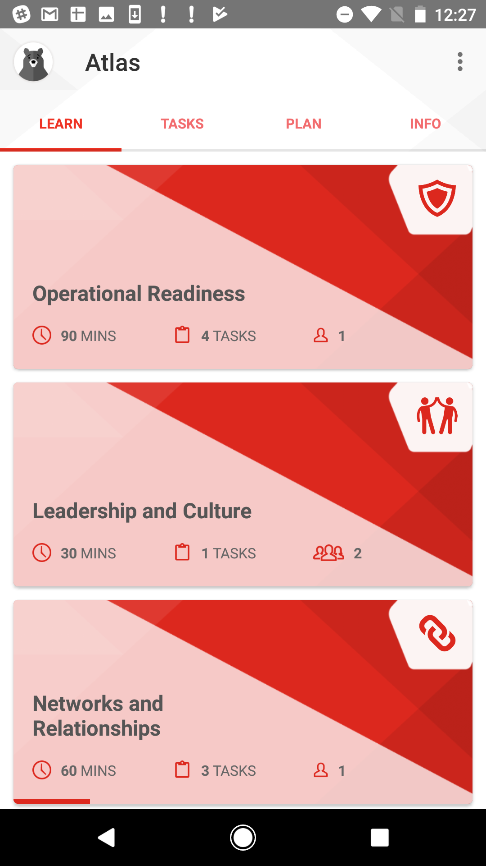
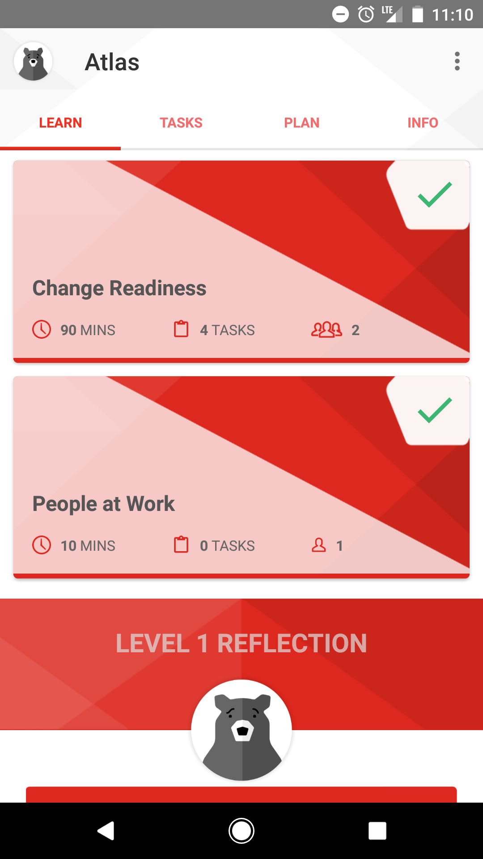
Notes:
The app guides businesses owners to consider operational readiness, networks and relationships, leadership and culture, change readiness, and their ability to assist their people at work. Business owners are then tested with real-world disaster scenarios with increasingly challenging levels including a level focused on epidemic preparedness.

Slide 6
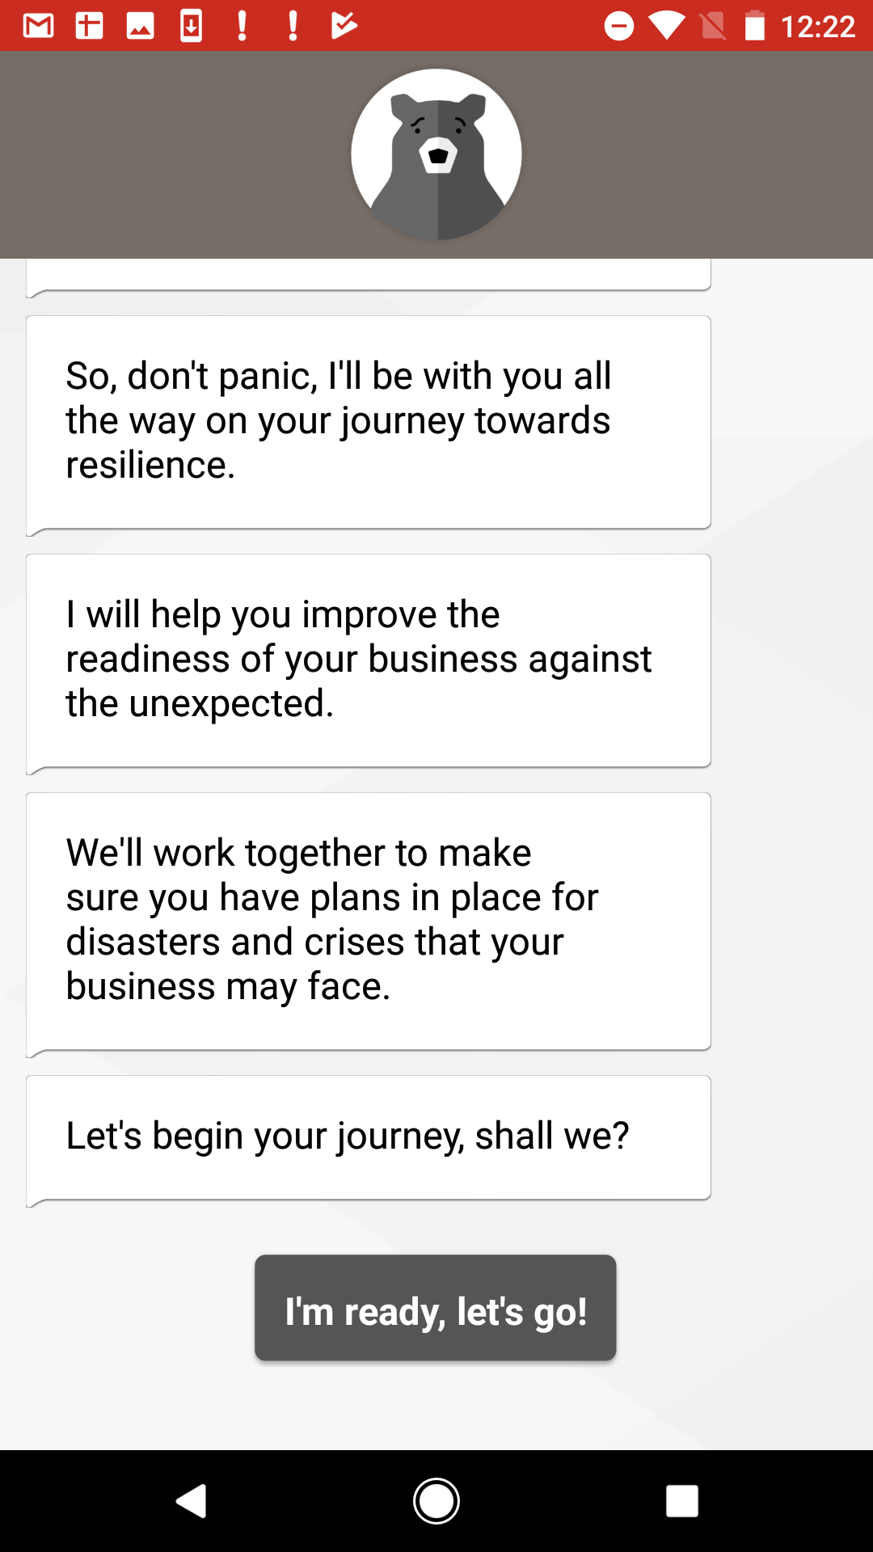
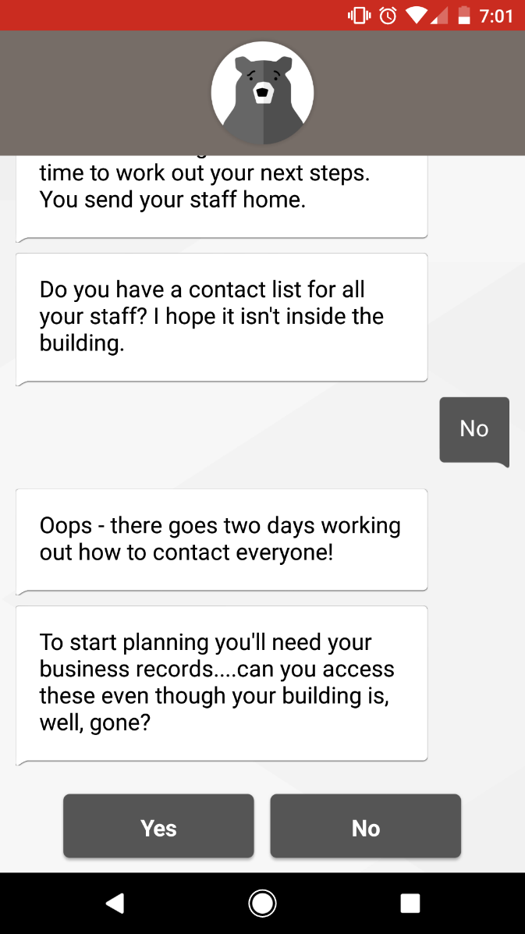
Notes:
The mobile application utilizes interactive features, including a human-like chat that messages with the user to gain insights to guide them on their unique journey towards resilience. This journey is enabled through Atlas’s flexible content which will tailor the content based on a users sector-specific preferences.

Slide 7
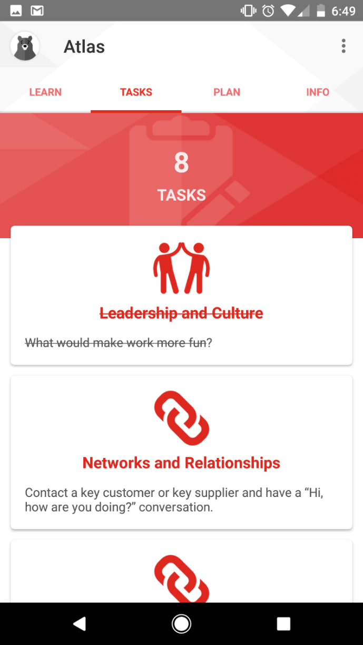
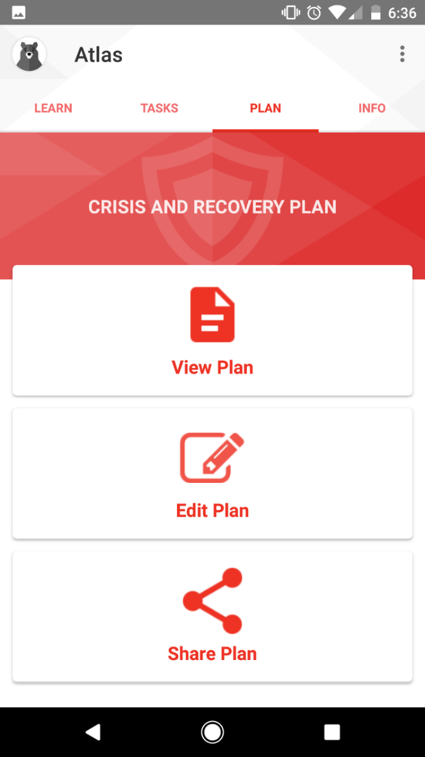
Notes:
As users complete tasks (alone or alongside their employees). Atlas automatically generates a shareable ‘Crisis and Recovery Plan’ which can be used not only during disasters, but also to exercise readiness and educate staff.

Slide 8
Thanks
to our funders
Notes:
The Business Preparedness Initiative in Uganda is made possible through the generous support of the UPS Foundation and USAID (via the complimentary Community Epidemic and Pandemic Preparedness Program)

Slide 9
Questions?

Slide 10
Multi-stakeholder working groups
Challenge the status quo
Rapid prototyping
Researched-based dimensions of resilience
Notes:
effectively, the creation of the Business Preparedness Initiative included diverse multi-stakeholder working groups to determine service offerings and value propositions, a willingness to challenge the status quo of current business continuity programming, rapid prototyping, and thorough research on dimensions of organizational resilience which guide users to look inward at their business and people and outward at their community and supply chains.

